Slide 1
CLOUD FRONT (CDN)
Abilash S R

Slide 2
What is CDN?
AWS CloudFront uses a global Network
More than 80 edge locations
More than 10 regional edge caches for Content delivery
That edge locations are located in multiple countries around the globe and the number also frequently increases
These helps your application to interact with low latency
For ex if your application is running in Singapore but users in Newyork you can use cloud front to cache content locally in Newyork

Slide 3
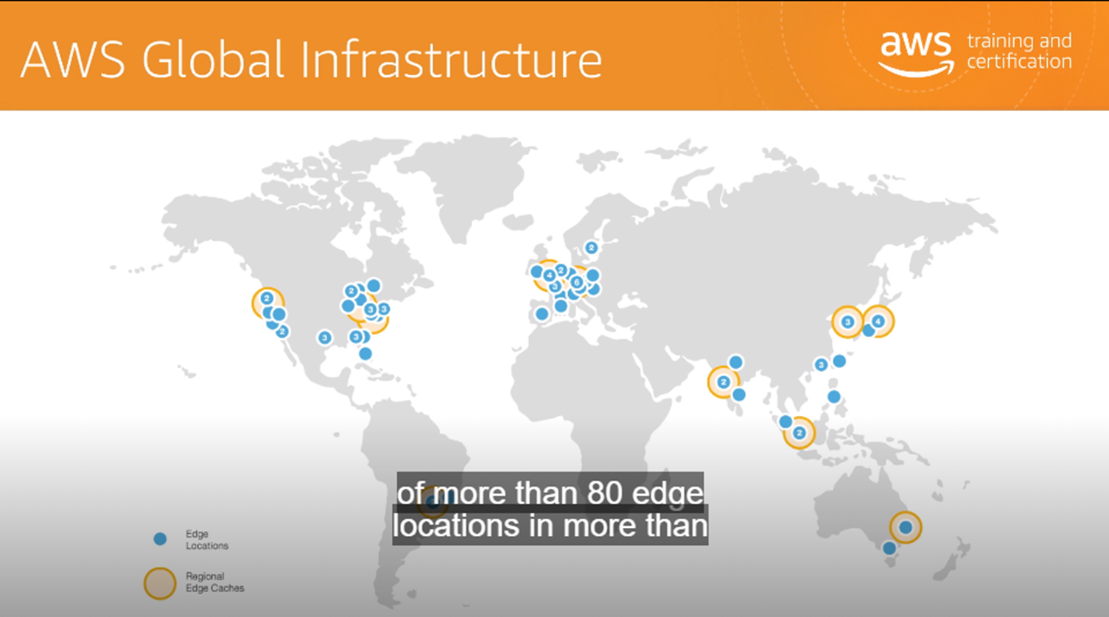

Slide 4
Cont..
Web used for web applications
RTMP used for video streaming
You can serve application inside AWS or outside AWS application
If it’s a Static web apps if the origin fails you can still able to access your data's from cloud front

